Slide 1

Perceptual Face Abilities of Face Examiners for Varying Tasks
Amy N. Yates*, Jacqueline Cavazos+, Ying Hu+, Geraldine Jeckeln+,
Eilidh Noyes++, Carina A. Hahn*, Alice J. O’Toole+,
P. Jonathon Phillips*
* NIST, + University of Texas at Dallas, ++ University of Huddersfield

Slide 2
Outline
Brief Backstory
Current Study
Across Races
Face Memory
Disguised Faces

Slide 3
A Brief Backstory

Slide 4
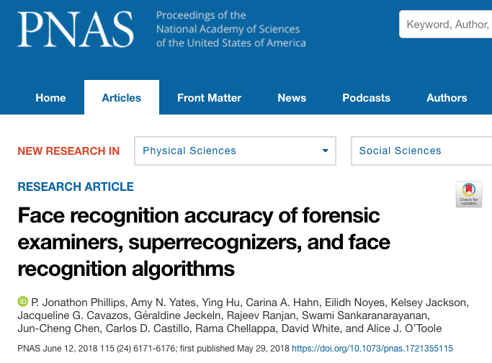
Proceedings of National Academy of Sciences

Slide 5
General Rules
Administered remotely
Examiners could use their tools and methods
20 pairs of face images
3 months to complete comparisons

Slide 6
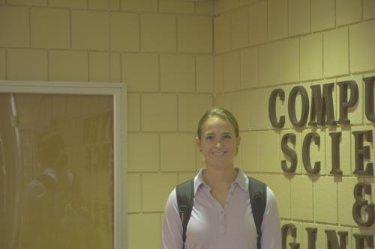
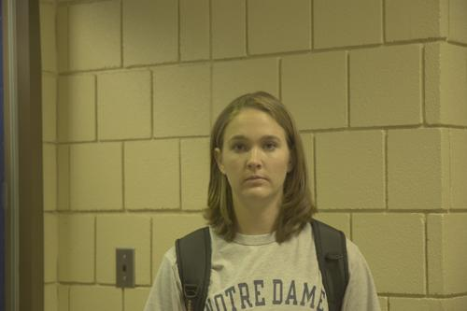
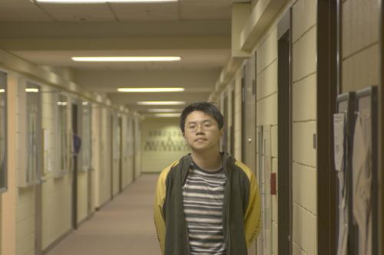
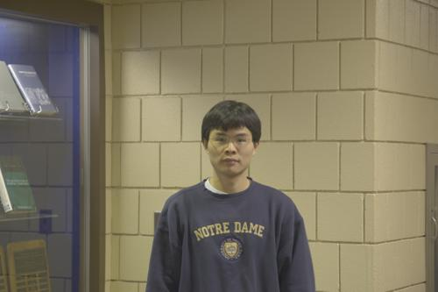
Example of Image Pairs
Same-identity pair
Different-identity pair

Slide 7
Comparison Across Groups
Individual
Median
Area Under the ROC Curve

Slide 8
Comparison Across Groups
Area Under the ROC Curve

Slide 9
PNAS Conclusions
Facial examiners are significantly better than the general population
No statistical difference among examiners, reviewers, and super-recognizers.
Best algorithm is competitive with best humans
Fusing human judgements is effective
Performance optimized by fusing one facial examiner and A2017b.

Slide 10
Current Perceptual Study
Investigate extent of examiners’ ability
Multiple tests investigating different areas
Perceptual tests (limited time, no tools or methods)
Faces of different races
Face memory
Disguised faces
Examiners: over web or on NIST laptop
Students: University of Texas at Dallas

Slide 11
Black Box Road Map
Perceptual test with students
Perceptual test with face professionals (e.g., face examiners)^{[1]}
Black box test
^{[1]}D. White, P.J. Phillips, C.A. Hahn, M. Hill, and A.J. O’Toole, “Perceptual expertise in forensic facial image comparison,” Proceedings of the Royal Society B, 282(1814), 2015.
DOI: 10.1098/rspb.2015.1292

Slide 12
Black Box Road Map
Perceptual test with students
Perceptual test with face professionals (e.g., face examiners)
Black box test

Slide 13
Performance Across Races

Slide 14
Why across races?
The other race effect (ORE) is when it is easier to recognize faces of one’s own race than it is to recognize faces of a different race.
It is important to know how well face examiners perform across different races.
Test based on imagery in Phillips et al. (2011)^{[2]}, contains equal sets of Caucasian and East Asian faces.
^{[2]}P. J. Phillips, F. Jiang, A. Narvekar, J. Ayyad, and A. J. O’Toole, “An other-race effect for face recognition algorithms,” ACM Trans. Appl. Percept., vol. 8, Feb. 2011. DOI: 10.1145/1870076.1870082

Slide 15
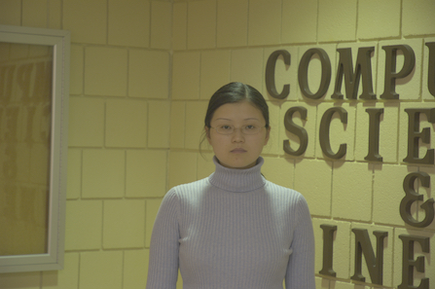
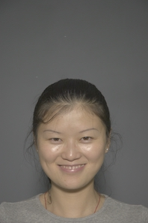
Example Image Pairs
+2 : Sure they are the same
+1 : Think they are the same
0 : Do not know
-1 : Think they are not the same
-2 : Sure they are not the same
Same Identity

Slide 16
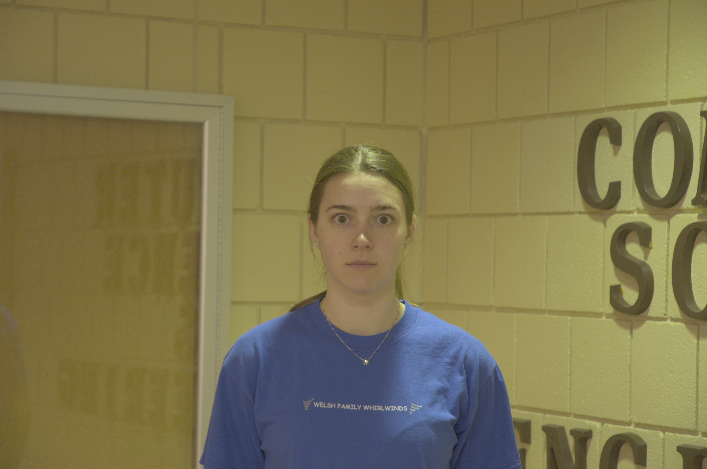
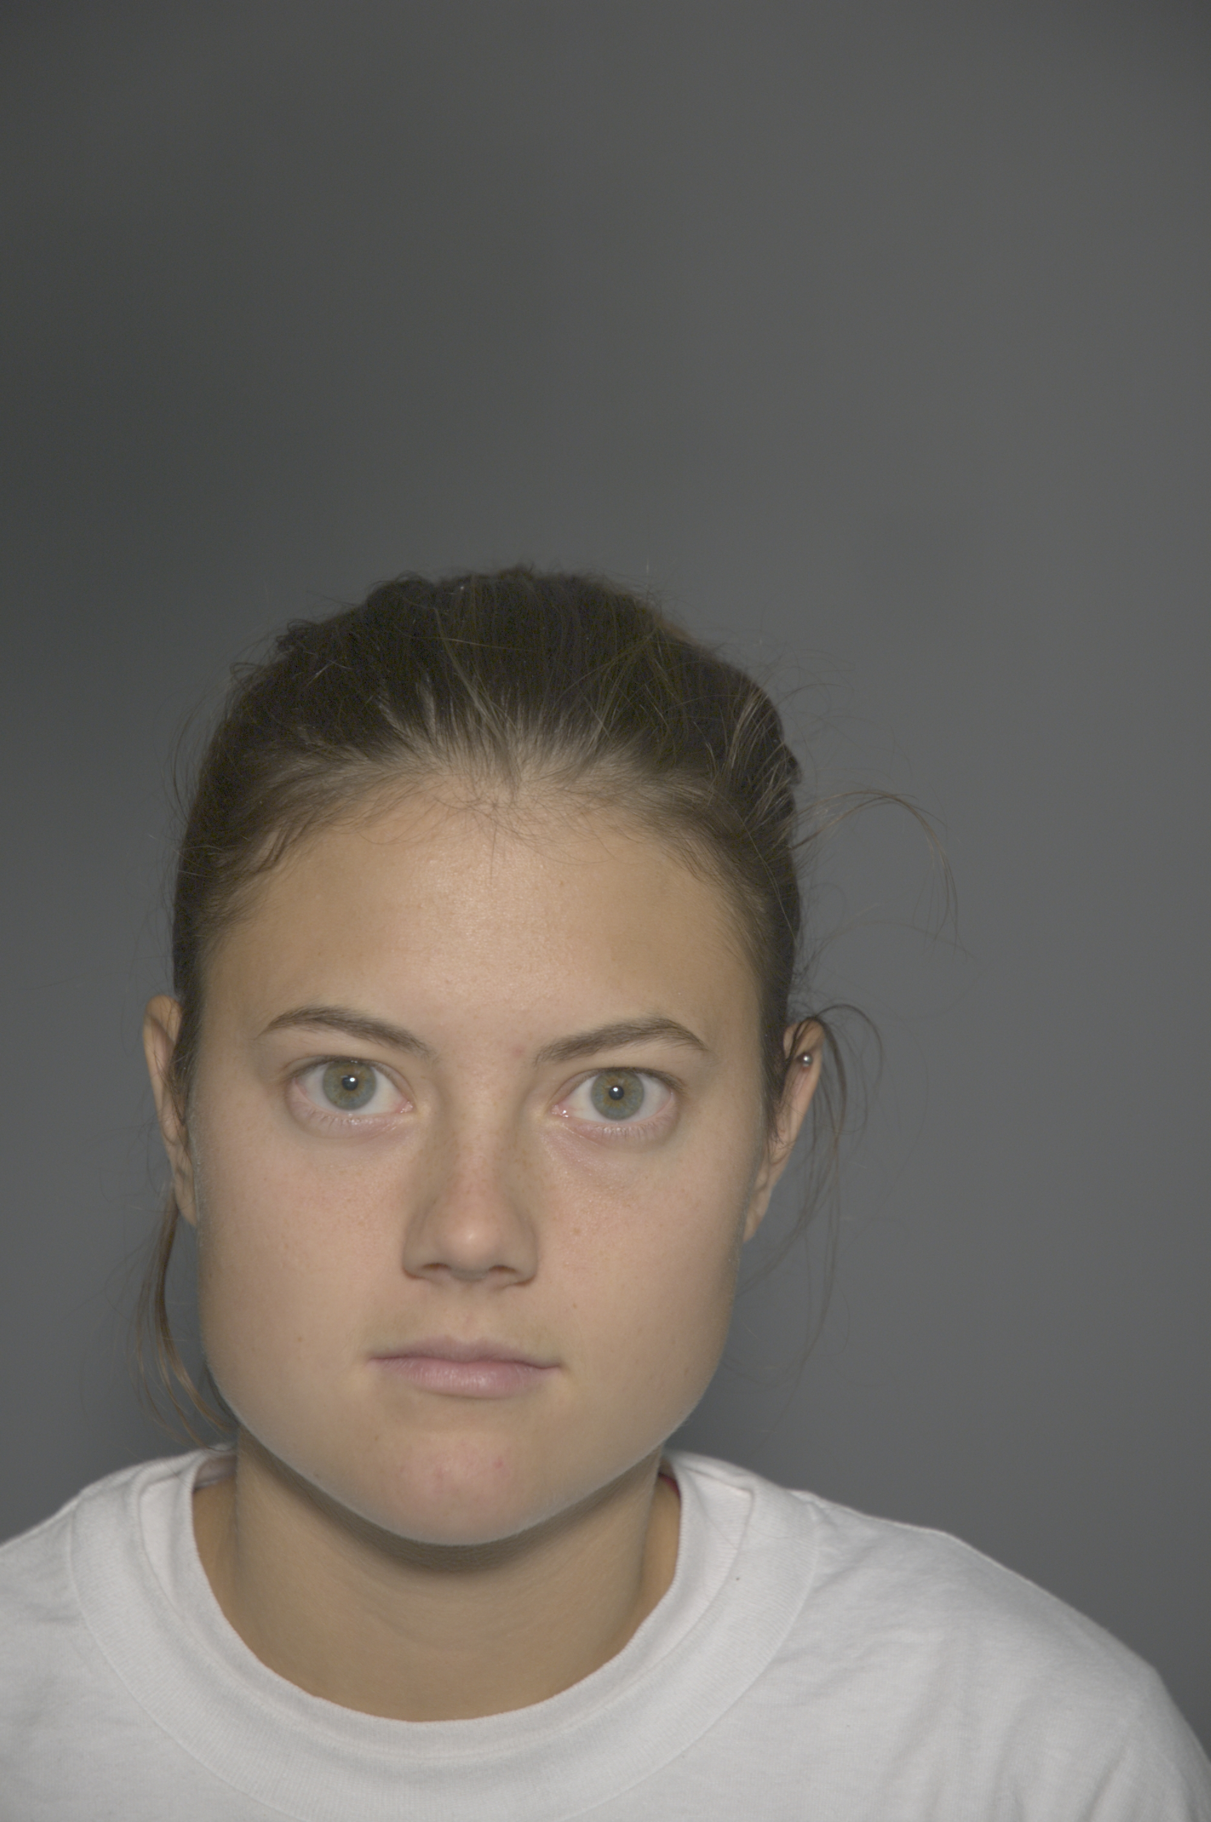
Example Image Pairs
+2 : Sure they are the same
+1 : Think they are the same
0 : Do not know
-1 : Think they are not the same
-2 : Sure they are not the same
Different Identities

Slide 17
Cross-Race Test
80 pairs of face images
Caucasian faces
East Asian faces
Up to 30 seconds to view each pair
14 Examiners (Caucasian ancestry)
48 Caucasian Students

Slide 18
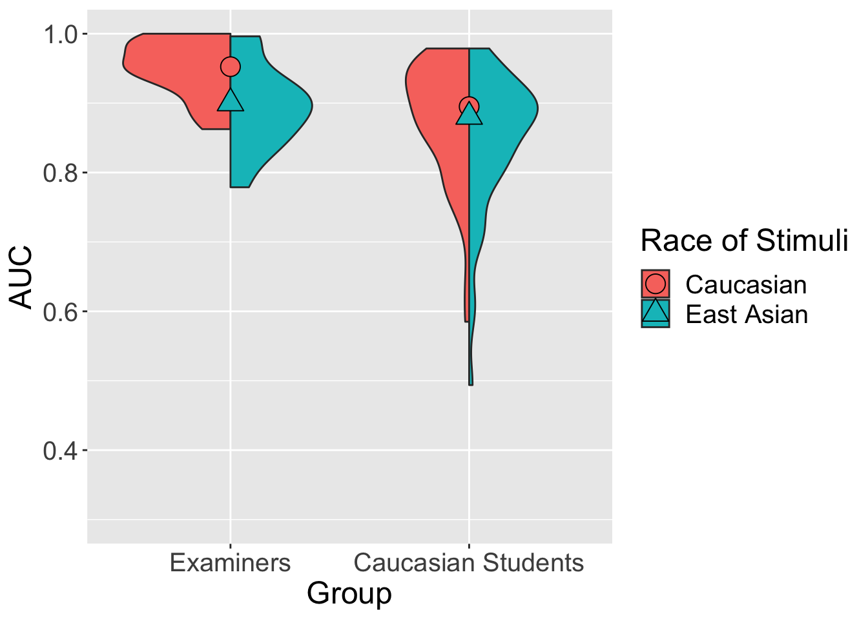
Both Stimuli Sets
Caucasian Stimuli
Examiners > Caucasian Students (p=0.00123**)
East Asian Stimuli
Examiners = Caucasian Students (p=0.123)
Caucasian Stimuli
East Asian Stimuli

Slide 19
Cambridge Face Memory Test (CFMT+)

Slide 20
Why memory?
Face examiners are trained in performing detailed, scientific facial comparisons.
It is important to know if face examiners’ skills are specific to comparisons or if they possess superior ability in general face tasks.
The long form of the Cambridge Face Memory Test (CFMT+)^{[3]} measures the ability of participants face memory and includes items designed to measure high ability performers.
^{[3]}R. Russell, B. Duchaine, and K. Nakayama, “Super-recognizers: People with extraordinary face recognition ability,” Psychonomic Bulletin & Review, vol. 16, pp. 252—257, 2009. DOI: 10.3758/PBR.16.2.252

Slide 21
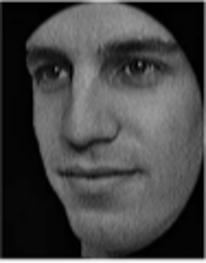
Memorize

Slide 22
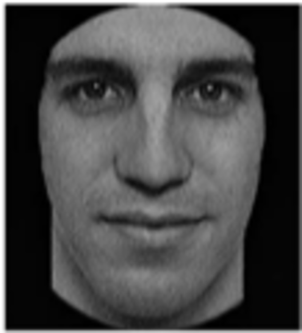
Memorize

Slide 23
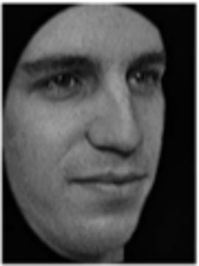
Memorize

Slide 24
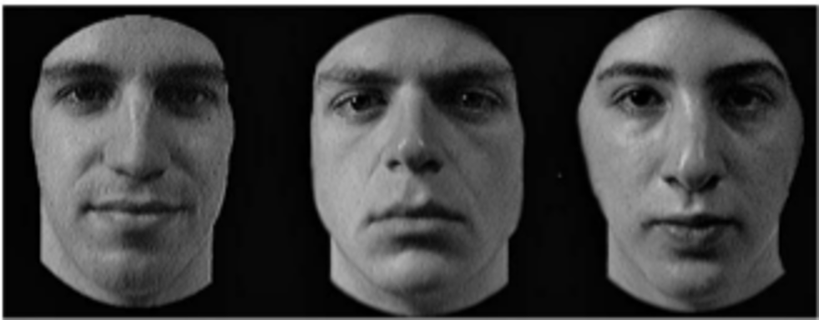
Which face did you just see?
A
B
C

Slide 25
CFMT+
120 face trios
13 Examiners (not taken before)
48 Caucasian Students

Slide 26
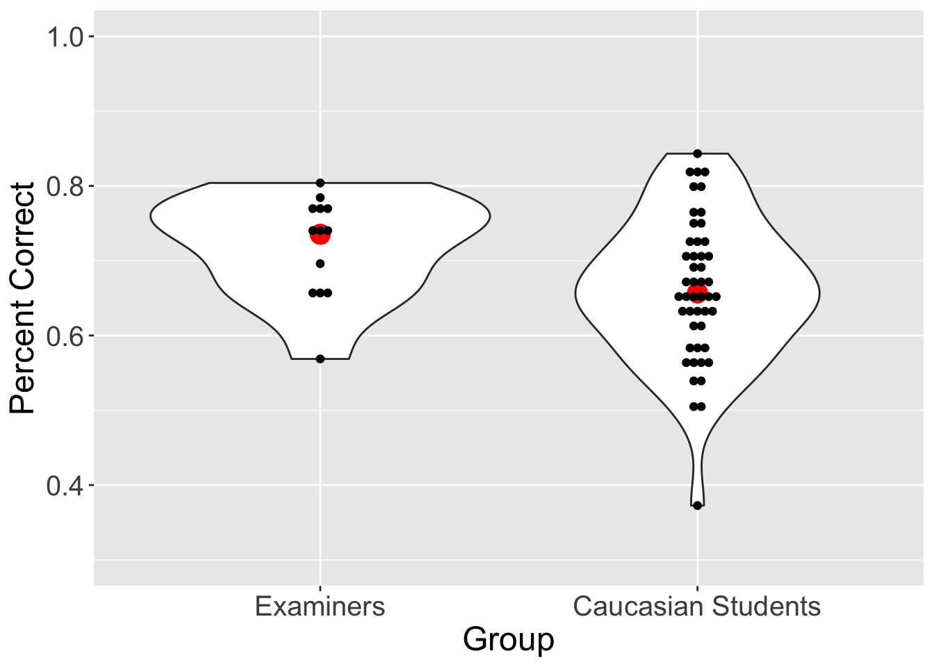
Face Memory
Examiners > Caucasian Students (p=0.0329*)

Slide 27
Disguised Faces

Slide 28
Why disguises?
Two ways to disguise oneself:
Evasion: alter appearance to not look as oneself
Impersonation: alter appearance to look like a specific other person
Test based on imagery from Noyes and Jenkins (2019)^{[4]}, containing images people disguised both ways.
^{[4]}E. Noyes and R. Jenkins, “Deliberate disguise in face identification,” Journal of Experimental Psychology: Applied, vol. 25, pp. 280–290, 2019. DOI: 10.1037/xap0000213

Slide 29

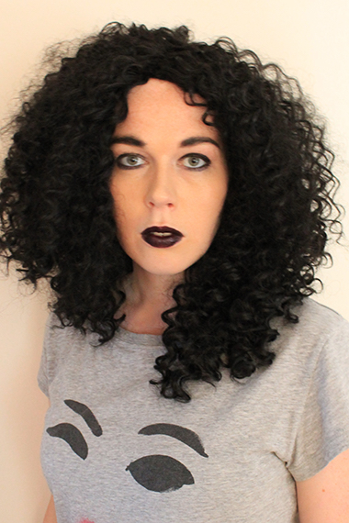
Example Image Pairs
+2 : Sure they are the same
+1 : Think they are the same
0 : Do not know
-1 : Think they are not the same
-2 : Sure they are not the same
Evasion (Same Identity)

Slide 30
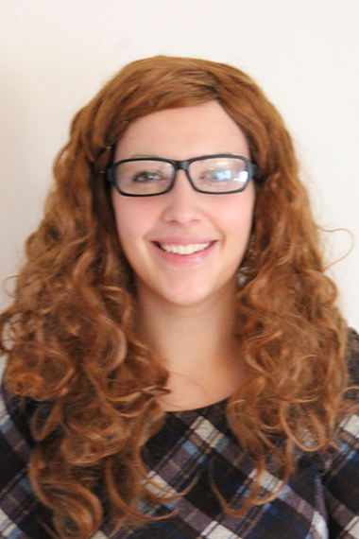
Example Image Pairs
+2 : Sure they are the same
+1 : Think they are the same
0 : Do not know
-1 : Think they are not the same
-2 : Sure they are not the same
Impersonation (Different Identities)

Slide 31
Façade Test
72 pairs over 3 conditions
No disguise: each person in the pair presents as themselves
Evasion: in same-identity pairs, person tries not to look like themselves
Impersonation: in different-identity pairs, person tries to look like another person
Up to 30 seconds to view each pair
14 Examiners
48 Caucasian Students

Slide 32
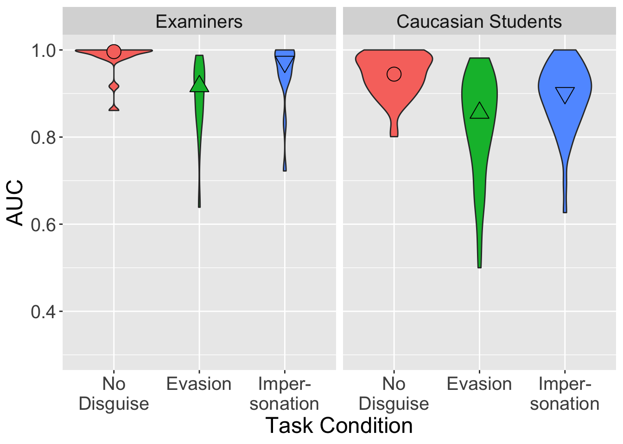
All Conditions
No Disguise Condition
Examiners > Caucasian Students (p=0.00127**)
Evasion Condition
Examiners = Caucasian Students (p=0.0652)
Impersonation Condition
Examiners > Caucasian Students (p=0.00287**)

Slide 33
Conclusions
Perceptual tests
Limited time
No tools or methods
Black box needed
Cross-Race Comparisons
Caucasian stimuli: examiners better than Caucasian students
East Asian stimuli: examiners equal to Caucasian students
Face Memory
Examiners better than Caucasian students
Disguised Faces
No disguise: examiners better than Caucasian students
Evasion: examiners equal to Caucasian students
Impersonation: examiners better than Caucasian students
X

Slide 34
Conclusions
Perceptual tests
Limited time
No tools or methods
Black box needed
Cross-Race Comparisons
Caucasian stimuli: examiners better than Caucasian students
East Asian stimuli: examiners equal to Caucasian students
Face Memory
Examiners better than Caucasian students
Disguised Faces
No disguise: examiners better than Caucasian students
Evasion: examiners equal to Caucasian students
Impersonation: examiners better than Caucasian students
X

Slide 35
Conclusions
Perceptual tests
Limited time
No tools or methods
Black box needed
Cross-Race Comparisons
Caucasian stimuli: examiners better than Caucasian students
East Asian stimuli: examiners equal to Caucasian students
Face Memory
Examiners better than Caucasian students
Disguised Faces
No disguise: examiners better than Caucasian students
Evasion: examiners equal to Caucasian students
Impersonation: examiners better than Caucasian students
Deeper understanding of examiners’ abilities

Slide 36
Thank you!

